Slide 1

Offshore wind plant optimization, from strategic planning to energy production maximization
2024

Slide 2
Offshore wind plant optimization, from strategic planning to energy production maximization
Mauricio Hernández, D.Sc. – CEPEL, Eletrobras
Postdoctoral researcher at PUC-Rio
October 1st, 2024

Slide 3


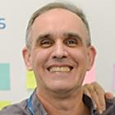
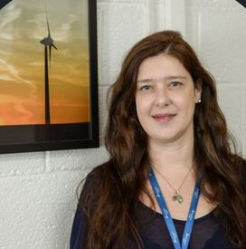
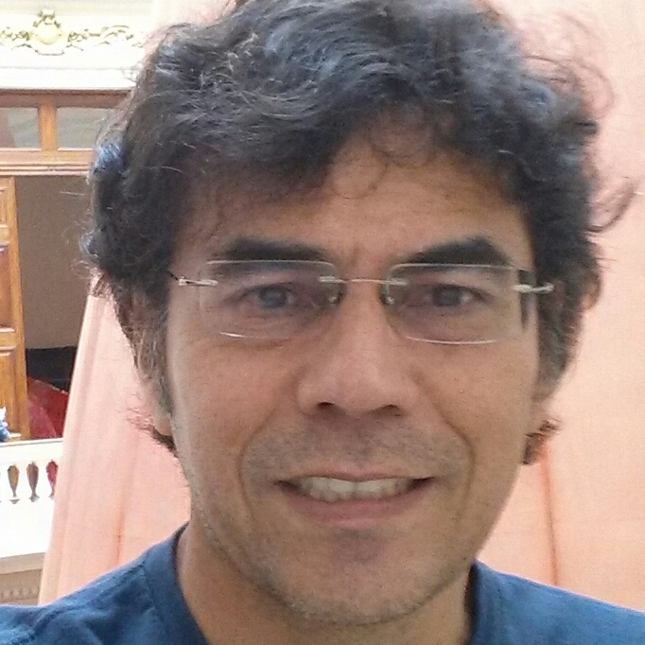
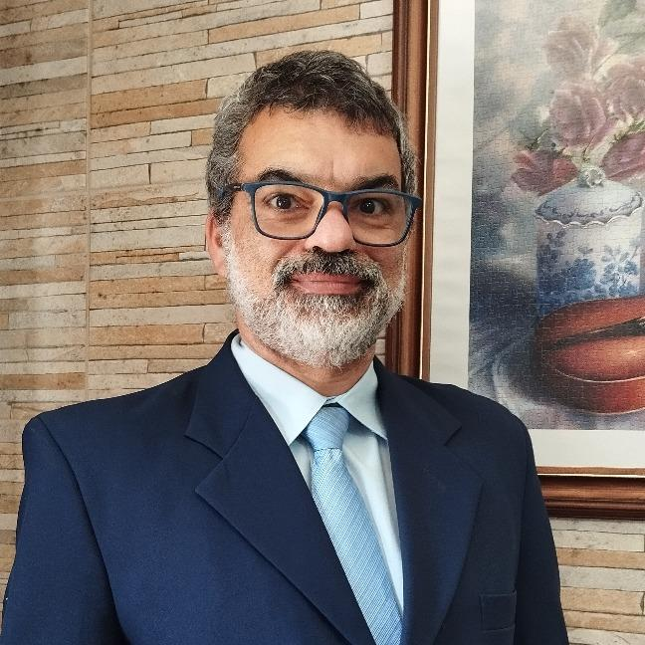
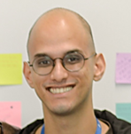
Offshore wind team
Mauricio Hernández, D.Sc.
Offshore wind planning and sustainability expert
CEPEL, Eletrobras
omauriciohernandez-bolsista@cepel.br
Katia Garcia, D.Sc.
Head of Department of
Energy Transition and Sustainability
CEPEL, Eletrobras
garciak@cepel.br
Sergio Melo, M.Sc.
Wind energy and GIS optimization expert
CEPEL, Eletrobras
sergiorf@cepel.br
Vanessa Guedes, D.Sc.
Wind energy team leader
CEPEL, Eletrobras
vanessag@cepel.br
Angelo Mustto, D.Sc.
Wind resource expert
CEPEL, Eletrobras
mustto_ext@cepel.br
Ricardo Dutra, D.Sc.
Wind energy expert
CEPEL, Eletrobras
dutra@cepel.br
Vitor Pinheiro
AI and O&M optimization expert
CEPEL, Eletrobras
vitorpinheiro_ext@cepel.br

Slide 4
Study’s aim
SPOWER-BR
Procedure
Methodology
GIS-SPOWER-BR Geodatabase
Baseline data
VIZ-SPOWER-BR
Dashboard
Geoanalytics & Visualization
GIS-SPOWER-BR Toolbox
Geospatial
Modeling tools
Present a practical application of the GIS-SPOWER-BR framework to optimize the energy production of an offshore wind plant based on sustainable development assumptions.
GIS-SPOWER-BR Framework
Source: Hernández (2024).

Slide 5
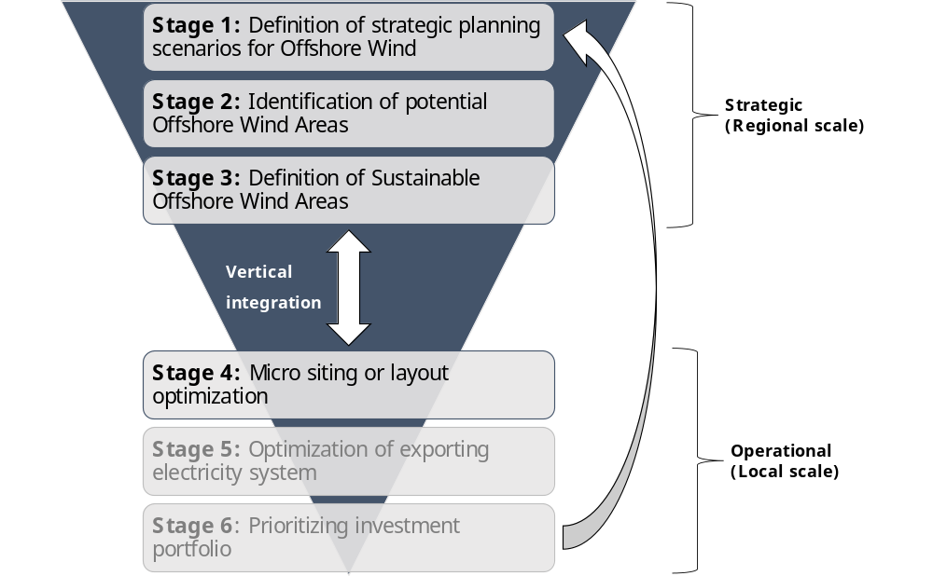
Mathodological approach
Figure 3‑1. GIS-SPOWER-BR methodology
Source: Hernández (2024).

Slide 6
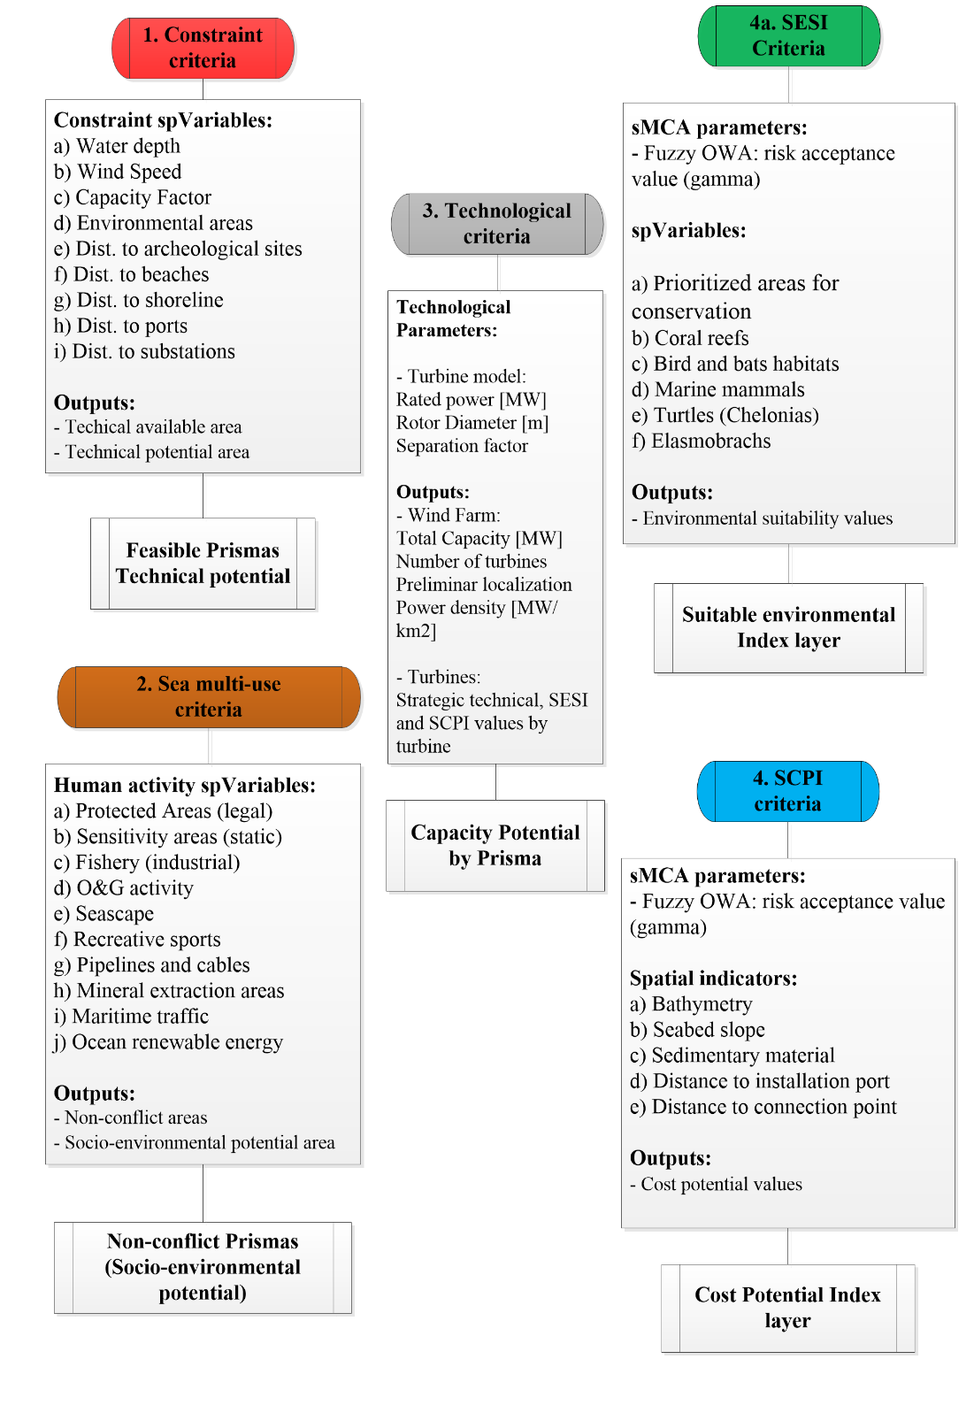
Strategic planning optimization
Base Scenario 2023 (Scenario A1) | Sustainable Optimization (Scenario B1)
Describes the current situation of planning and regulatory framework. There is no integrated instrument or tool to address the strategic planning of offshore wind energy development. It assumes minimal restrictions, minimal analysis of conflicts of use in the sea and no minimum distance from the coast as a strategy to avoid future environmental problems or social opposition. It does not consider any restrictions on total installed capacity or distancing between projects. The technology is based on current projects (by 2023). Sea-use competition assumptions: Protected areas: Fed. & Ste. UCs (IP) Military areas: All areas Oil and Gas: Blocks and production fields Infrastructure: Buffer 500m from pipelines Mineral extraction: N/C Fishery Industrial: N/C Maritime traffic: N/C Tourism: N/C Offshore RE: All planned OWFs | Describes the situation with a balance between factors, integrating the concept of trade-off in the environmental, social, and economic dimensions to ensure the sustainability of the industry's development. Based on sustainable development, this scenario aims to reduce environmental and social impacts while increasing economic growth. The technology focuses on large-scale technology with high performance. Constraints assumptions: Bathymetry: > 200 m.u.s.l. Average wind speed: < 7 m/s Capacity Factor (reference): < 30 % Environmental vulnerability: UCs + Ex. High APCB Min. distance to shore: < 10 km Archeological sites: < 3 km Touristic beaches buffer: < 14 km Max. Distance to shore: > 150 km Max. Distance to ports: > 300 km Max. Distance to grid connection (SS): > 100 km

Slide 7
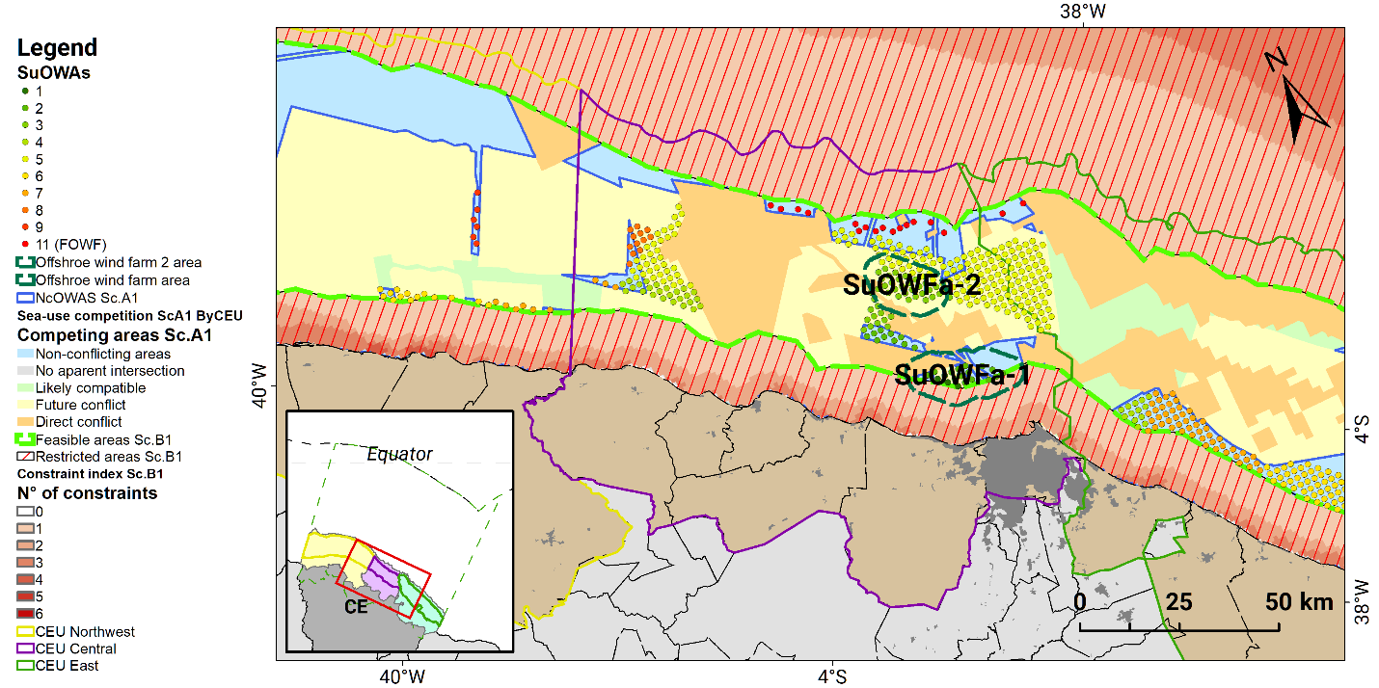
Strategic planning optimization

Slide 8
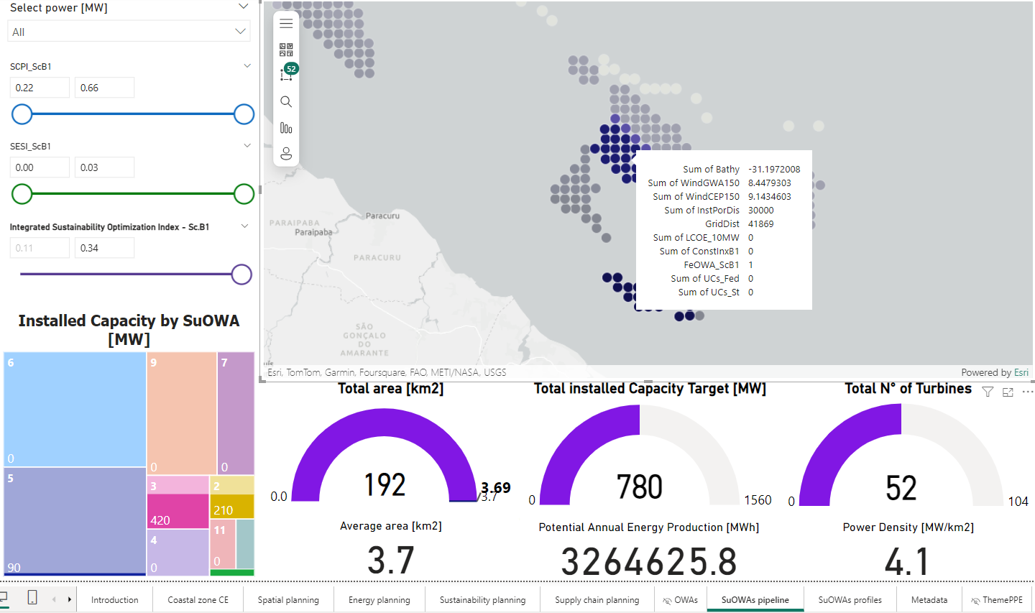
Strategic planning optimization
We used VIZ-SPOWER-BR Dashboard to analyze metrics and select the best options.

Slide 9
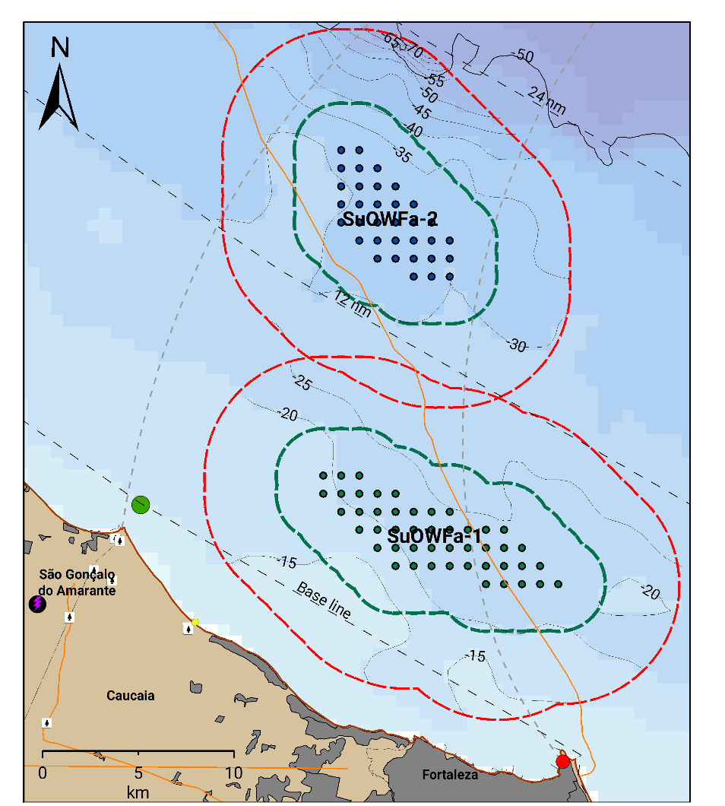
Wind energy production optimization
OWF | Mean Bathy. | Mean Slope | Mean Wind Speed GWA150 [m/s] | Mean Ref. CF GWA IE1 | Mean Dist. to shore [km] | Mean Dist. to Install. port [km] | Mean Dist. to Grid [km] | Mean SCPI | Mean SESI | RAEP* [GWh]
SuOWFa-1 | -21.7 | 9% | 8.4 | 47.6% | 15.5 | 25.0 | 32.7 | 0.269 | 0.000 | 1,961.6
SuOWFa-2 | -31.2 | 5% | 8.4 | 47.8% | 33.8 | 32.2 | 44.1 | 0.270 | 0.000 | 1,423.0
Offshore wind plant | 10-MW turbines* | Capacity potential* [MW] | 12-MW turbines | Capacity potential [MW] | 15-MW turbines | Capacity potential [MW] | Total area [km²]
SuOWFa-CE-1 | 47 - 60 | 470 - 600 | 33 | 396 | 26 | 390 | 311.7
SuOWFa-CE-2 | 34 - 45 | 340 - 450 | 24 | 288 | 25 | 375 | 231.5
Small commercial plant

Slide 10
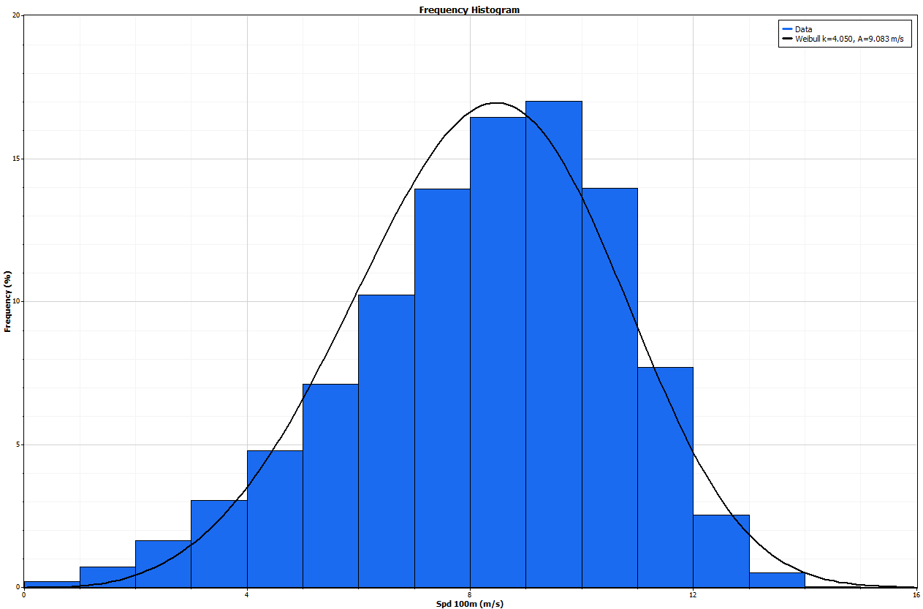
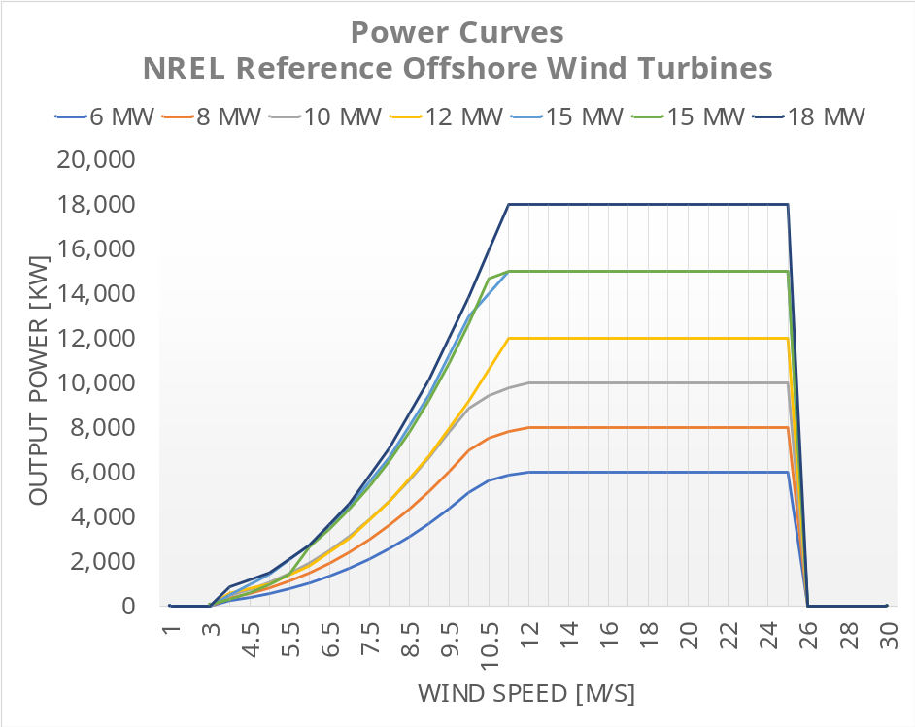
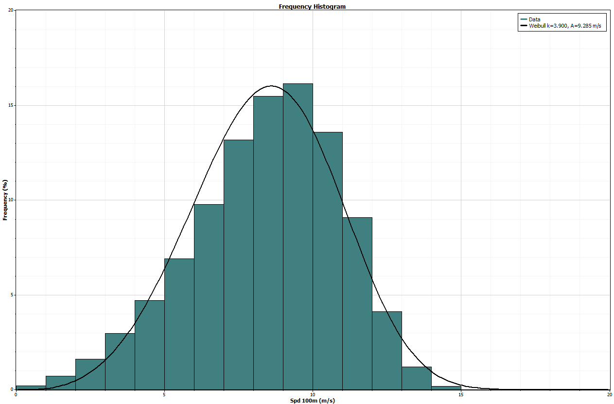
Wind energy production optimization
8 – 10 m/s

Slide 11
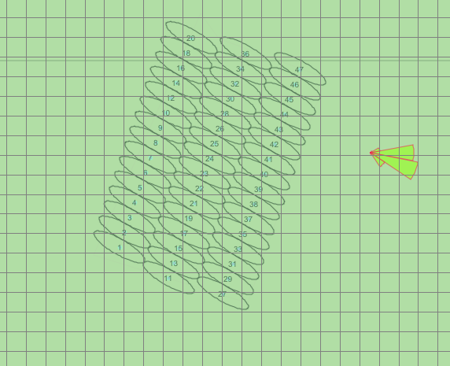
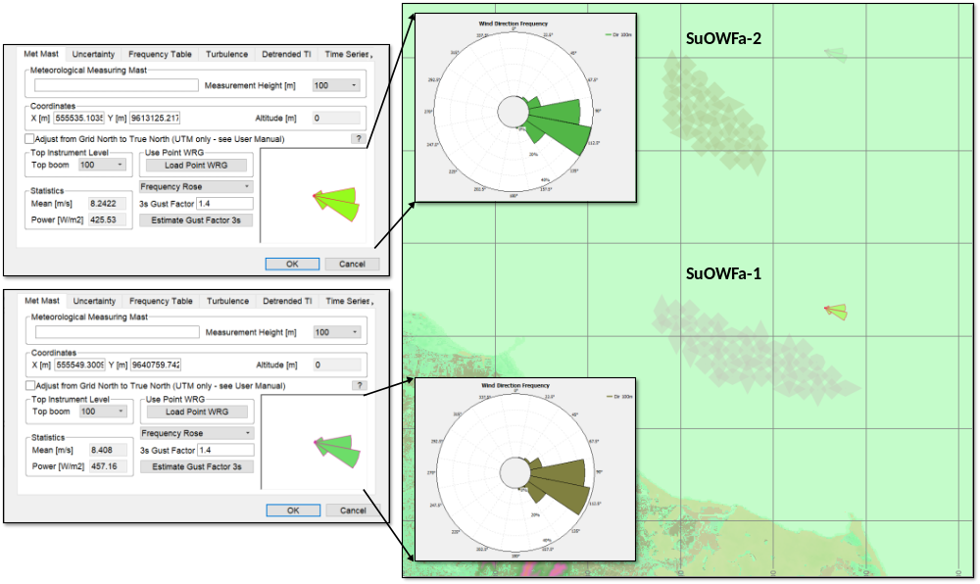

Wind energy production optimization

Slide 12
Impact on offshore wind plant metrics
OWF | No. of Turbs. | Ideal Energy [GWh] | Theoretical Gross Energy [GWh] | Gross Energy [GWh] | Net Energy [GWh] | Capacity Factor [%] | Topographic Efficiency [%] | Array Efficiency [%]
SuOWFa-1 | 47 | 2,387 | 2,387 | 2,387 | 1,858 | 45.1 | 100.0 | 77.8
SuOWFa-2 | 31 | 1,777 | 1,777 | 1,777 | 1,499 | 50.3 | 100.0 | 84.3
Early planning
OWF | No. of Turbs. | Ideal Energy [GWh] | Theoretical Gross Energy [GWh] | Gross Energy [GWh] | Net Energy [GWh] | Capacity Factor [%] | Topographic Efficiency [%] | Array Efficiency [%]
SuOWFa-1opt | 47 | 2,387 | 2,387 | 2,387 | 2,084 | 50.6 | 100.0 | 87.3
SuOWFa-2opt | 31 | 2,248 | 2,248 | 2,248 | 2,067 | 54.8 | 100.0 | 91.9
Metrics impact | -34.0% | -5.8% | -5.8% | -5.8% | -0.8% | 8.4% | 0.0% | 5.3%
Optimized

Slide 13
Discussion
Higher Capacity Factors: Both offshore areas demonstrate significantly higher capacity factors compared to onshore environments, confirming the superior energy generation potential of offshore wind.
Critical Alignment with Wind Direction: Ensuring alignment with the predominant wind direction is essential for optimizing performance, yet many early-stage planning projects overlook this fundamental parameter.
Energy Optimization with Fewer Turbines: The optimized farther alternative (SuOWFa-2opt) achieves 99.2% of the energy output using 34% fewer turbines compared to the closer alternative (SuOWFa-1opt), demonstrating superior efficiency in layout and resource use.
Comprehensive Plant Optimization: Aligned with both current and anticipated regulatory frameworks, early-stage optimization can address:
  Maximization of energy production to ensure the highest economic return.
  Sustainable development of offshore wind farms, fostering long-term viability.
  Rational utilization of marine natural resources, ensuring minimal disruption.
  Harmonization of offshore wind farms with other marine space uses.
  Prevention and mitigation of potential environmental impacts.

Slide 14
Conclusion
The applied procedure represents a suitable dynamic/flexible practice for simulating and assessing site alternatives of the offshore wind projects under diverse likely future strategic scenarios.
In current case study, optimization of the SuOWFa-2opt wind plant demonstrated a higher increment in energy production, located further from 12 nm (22 km) from the shoreline and avoiding the most relevant sea-use conflicts, aligned with the Previous Interference Disclosure (DIP) and SToR for Environmental Licensing requirements.
Further studies should focus on optimizing energy transmissionusing softwares such as AMBIENTRANS® model to enhance exporting cable corridors, thereby minimizing socio-environmental impacts and costs.

Slide 15
References
[1] M. Hernandez C., “Strategic planning for offshore wind energy: a methodological framework for increasing its sustainability” Coppe UFRJ, 2024. Available: .
[2] AWS Truepower, “OpenWind Theoretical Basis and Validation,” no. April. UL Solutions, ALBANY, p. 27, 2009, [Online]. Available: https://collateral-library-production.s3.amazonaws.com/uploads/asset_file/attachment/51094/OpenWind_Theory_and_Validation-v3_HH_ULSolutions.pdf.
[3] UNESCO, International Guide on Maritime Spatial Planning. 2021.
[4] MMA/SQA, “Avaliação Ambiental Estratégica,” MMA, 2002.
[5] Ministerio de Minas e Energia, “Manual de Inventario Hidroelétrico e Bacias Hidrográficas,” Rio de Janeiro, 2007. [Online]. Available: https://www.gov.br/mme/pt-br/assuntos/secretarias/spe/publicacoes/manual-de-inventario-hidroeletrico-de-bacias-hidrograficas/documentos/manual-de-inventario-hidroeletrico-e-bacias-hidrograficas-edicao-2007-pdf.rar/view.
[6] EPRI, “Advanced Nuclear Technology: Site Selection and Evaluation Criteria for New Nuclear Energy Generation Facilities (Siting Guide): 2022 Revision,” 2022.
[7] M. Hernandez C., M. Shadman, M. M. Amiri, C. Silva, S. F. Estefen, and E. La Rovere, “Environmental impacts of offshore wind installation, operation and maintenance, and decommissioning activities: A case study of Brazil,” Renew. Sustain. Energy Rev., vol. 144, p. 110994, Jul. 2021, doi: 10.1016/j.rser.2021.110994.
[8] S. M. Maxwell et al., “Potential impacts of floating wind turbine technology for marine species and habitats,” J. Environ. Manage., vol. 307, no. June 2021, p. 114577, 2022, doi: 10.1016/j.jenvman.2022.114577.
[9] IBAMA, Termo de Referência: Estudo de Impacto Ambiental (EIA) e Relatório de Impacto Ambiental (RIMA), Tipologia: Complexos Eólicos Marítimos (Offshore). Brazil, 2020.
[10] MME and GM, Portaria Normativa GM/MME No 52-2022 - cessão de uso onerosa para exploração de central geradora de energia elétrica offshore. 2022, pp. 1–12.
[11] PR, Decreto No 10.946, de 25 de janeiro de 2022. 2022.
[12] SPU, Portaria SPU-ME N° 5.629 de 2022. 2022.
[13] Câmara dos Deputados, PL 5932/2023 - Política Geração Energia Renovável Offshore. Senado, 2023.
[14] The World Bank, “Scenarios for Offshore Wind Development in Brazil,” Washington, DC, 2024. [Online]. Available: http://creativecommons.org/licenses/by/3.0/igo.
[15] C. Schillings, T. Wanderer, L. Cameron, J. T. van der Wal, J. Jacquemin, and K. Veum, “A decision support system for assessing offshore wind energy potential in the North Sea,” Energy Policy, vol. 49, pp. 541–551, 2012, doi: 10.1016/j.enpol.2012.06.056.
[16] R. R. Yager, “On Ordered Weighted Averaging Aggregation Operators in Multicriteria Decisionmaking,” IEEE Trans. Syst. Man Cybern., vol. 18, no. 1, pp. 183–190, 1988, doi: 10.1109/21.87068.
[17] EPRI, “Planning for the Integration of Offshore Wind Generation,” Offshore Wind Integration, no. March. Electric Power Research Institute, Palo Alto, Mar. 2020.
[18] D. De Matos, S. De Melo, M. Da Silva, J. De Abreu, and V. Ramos, “Relatório referente à Prospecção do Potencial de Uso da Ferramenta AMBIENTRANS por Empresas do Setor Elétrico Brasileiro (Preliminar),” 2021.
[19] D. A. Ramos, V. G. Guedes, R. R. S. Pereira, T. A. S. Valentim, and W. A. C. Netto, “Further considerations on WAsP, OpenWind and WindSim comparison study: Atmospheric flow modelling over complex terrain and energy production estimate,” in Brazil Wind Power 2017, 2017, pp. 1–23, [Online]. Available: https://viegd.com.br/wpcontent/uploads/2017/08/BWP_2017_DANIEL_AGNESE_RAMOS_ARTICLE_2.pdf.
[20] P. Beiter et al., “A Spatial-Economic Cost- Reduction Pathway Analysis for U.S. Offshore Wind Energy Development from 2015–2030,” Natl. Renew. Energy Lab., no. September, p. 214, 2016.
[22] B. O’Loughlin, M. H. Bullard, and P. Beaucage, “2024 Offshore Backcast by UL Solutions, Pre-construction Wind Energy Methods Validation,” 2024.
[23] P. Bortolotti et al., “Systems Engineering in Wind Energy - WP2.1 Reference Wind Turbines,” 2019. [Online]. Available: https://www.osti.gov/biblio/1529216-iea-wind-tcp-task-systems-engineering-wind-energy-wp2-reference-wind-turbines%0Ahttp://www.osti.gov/servlets/purl/1529216/.
[26] M. Hernandez C., E. Ricarte, and E. La Rovere, “Certificado de Registro de Programa de Computador: GIS-SPOWER-BR - Processo N°: BR512022001514-5,” DETEC, no. February. INPI, Rio de Janeiro, p. 2, 2022.

Slide 16
Contact
Mauricio Hernández, D.Sc.
CEPEL, Eletrobras
Leading expert in offshore wind energy with a Doctorate in Energy and Environmental Planning. Currently, he serves as a Postdoctoral Researcher in the Energy Transition Department at the Power Research Center, Eletrobras, and at PUC-Rio. He is also a Research Fellow at the Kühne Chair in Logistics (UniAndes – KLU). His work focuses on advancing strategic planning and sustainable energy solutions aligned with innovative logistics strategies for the energy transition and decarbonization.
Contact: omauriciohernandez-bolsista@cepel.br

