Slide 1





Use of Convolutional Neural Network to Failure Detection in WTs Drivetrains

Slide 2
Use of Convolutional Neural Network to Failure Detection in WTs Drivetrains
Eduardo Menezes, Ph.D.– CEO, Evoluce Tecnologia / Professor, Department of Mechanical Engineering, Federal University of Pernambuco

Slide 3
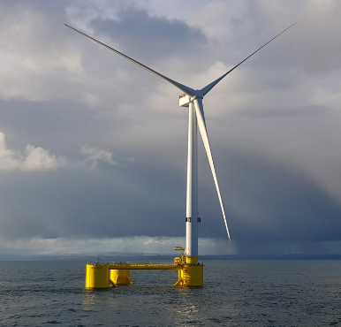
Agenda
Context
Predictive Maintenance
CNNs
Dataset
Failure Detection
Conclusions

Slide 4
Context
Many complex industrial sectors face the challenge of increasing
O&M efficiency:
Impacting the profitability during a project lifecycle, due to unforeseen failures
Even more pronounced in wind energy assets
  Harsh operational conditions (24/7 operation and variable loads)
  Coupled modal-multibody dynamics
O&M costs reaching 25-30% of the LCOE (NREL, 2022)

Slide 5
Context
In order to keep in track the 1.5ºC upper limit of global temperature:
Wind energy investments achieved the USD 180 billion in 2023 (IEA, 2024)
The investment in renewables must triple regarding the current level (WEO, 2023)
The search for reducing O&M costs plays a key role in the feasibility, including in the new offshore projects (in Brazil = 480 GW in fixed-bottom WTs)
Technological solution: predictive maintenance based on gathered data: SCADA and CMS systems
Drivetrain failures leading to the largest downtimes and costs (NREL, 2022)

Slide 6
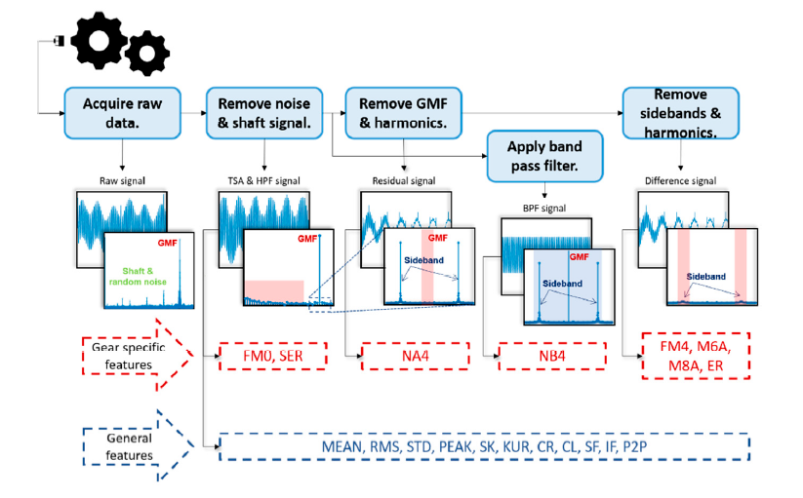
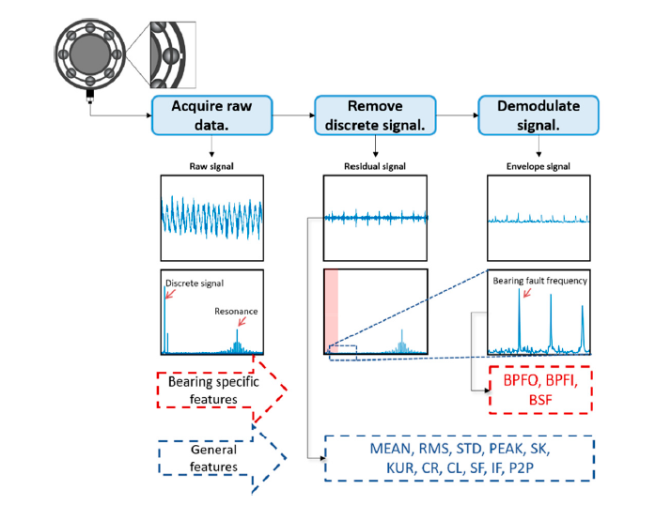
Predictive Maintenance
Although SCADA data could be used, CMS is often underestimated to run diagnosis and prognosis (= complexity of analysis and vibration analyst)

Slide 7
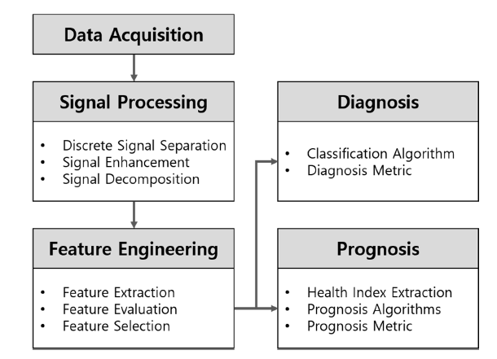
Predictive Maintenance
To overcome the common drawbacks of handling CMS data:
Development and use of deep learning tools
Capable of capturing nonlinear dynamics
Ability to cope with large data amount simultaneously
Utilization of convolutional neural networks (2D CNNs), primarily used for image recognition

Slide 8
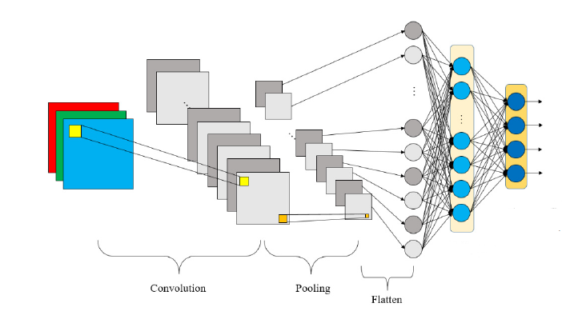
CNNs
Designed for recognizing complex patterns
Increasingly used for condition monitoring tasks
Spatial weights and spatial pooling
Application of matrices with kernel and stride sizes, operating in raw vibration data
Option for image data (2D)

Slide 9
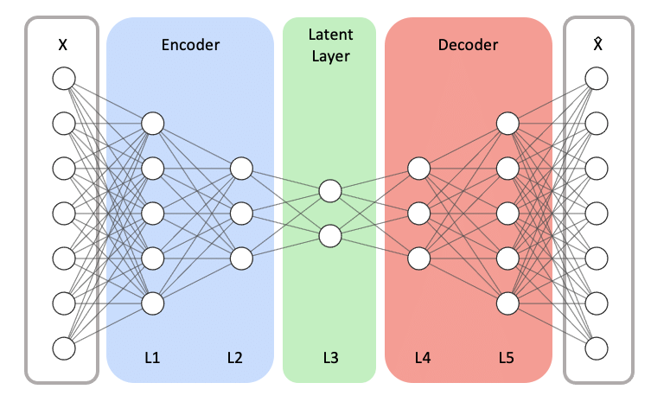
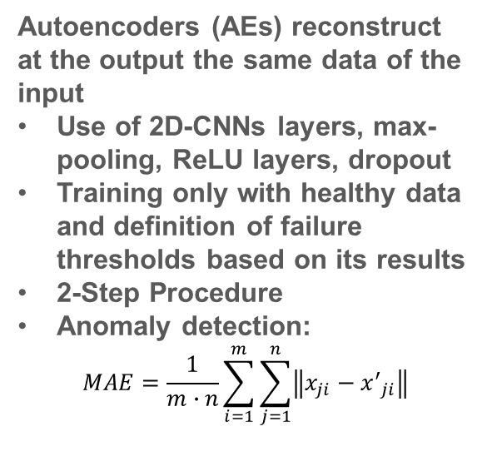
CNNs
Autoencoders (AEs) reconstruct at the output the same data of the input
Use of 2D-CNNs layers, max-pooling, ReLU layers, dropout
Training only with healthy data and definition of failure thresholds based on its results
2-Step Procedure
Anomaly detection:
$$MAE=\frac{1}{m∙n}\sum_{i=1}^{m}{\sum_{j=1}^{n}{\left\|x_{ji}−{x^{′}}_{ji}\right\|}}$$

Slide 10
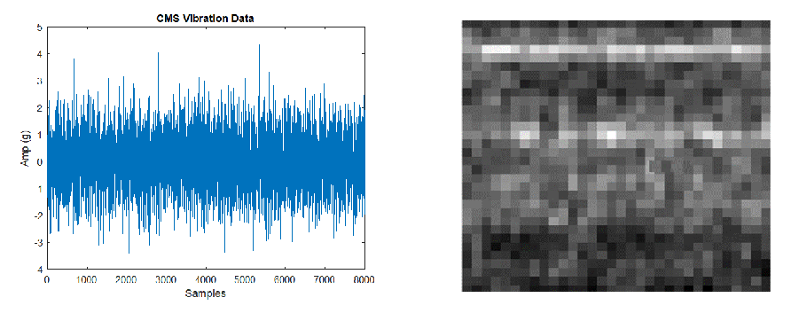
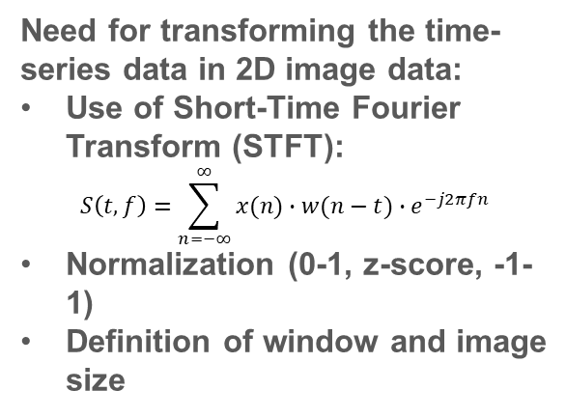
CNNs
Need for transforming the time-series data in 2D image data:
Use of Short-Time Fourier Transform (STFT):
$$S\left(t,f\right)=\sum_{n=−∞}^{∞}{x(n)∙w(n−t)∙e^{−j2πfn}}$$
Normalization (0-1, z-score, -1-1)
Definition of window and image size

Slide 11
CNNs - Utilized WT Dataset
CNNs diagnosis tool applied in a specific area from a commercial wind farm:
25 WTs, 1.68 MW, located in Bahia state, Northeast of Brazil
25600Hz of sampling rate, adjusted by synchronous sampling (Zhang, 2022), collected every 4 hours, 8192 points per sample
Use of maintenance logs revealing 2 reference WTs:
  Stages 1 and 3 from reference WTR1
  Stage 3 from WTR2
  Evaluation of WT5 and WT3
Use of 1 year of data (01/01/2022 – 31/12/2022), within a certain power band
70% for training (80%) and validation (20%) / 30% for test
  Definition of threshold on test set

Slide 12
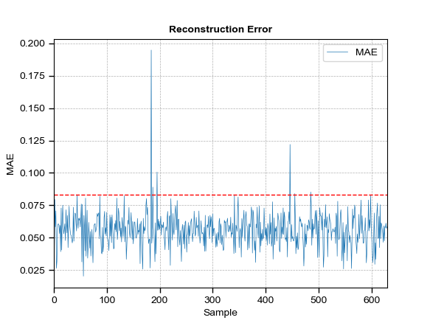
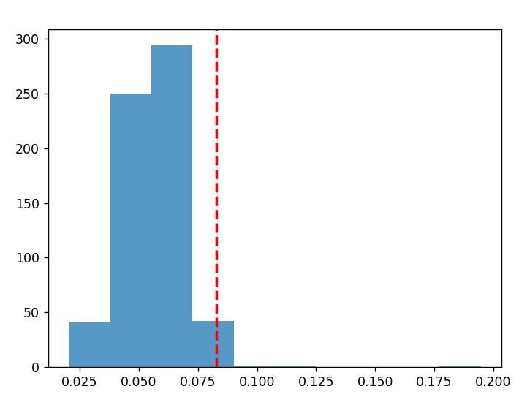
Failure Detection
1st Step: Application of Trained Neural Network to Healthy WTRs 1 and 2
Use of occurrence distribution – construction of histograms
99th Percentile
WTR 1 – Stage 3

Slide 13
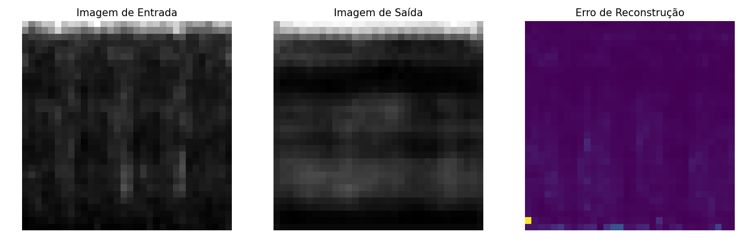
Failure Detection
1st Step: Application of Trained Neural Network to Healthy WTRs 1 and 2
WTR 1 – Stage 3

Slide 14
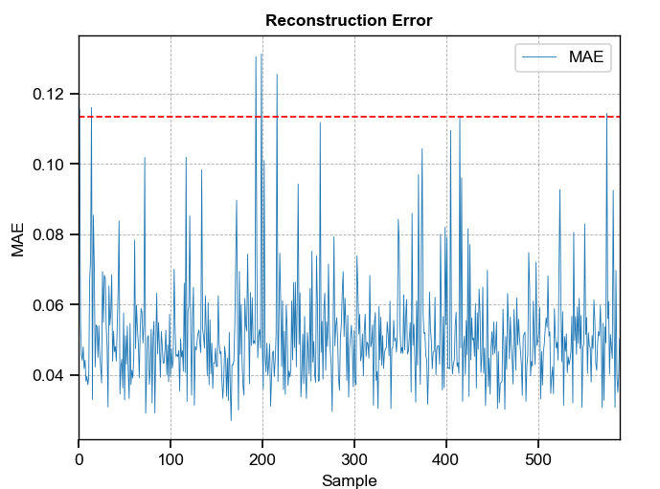
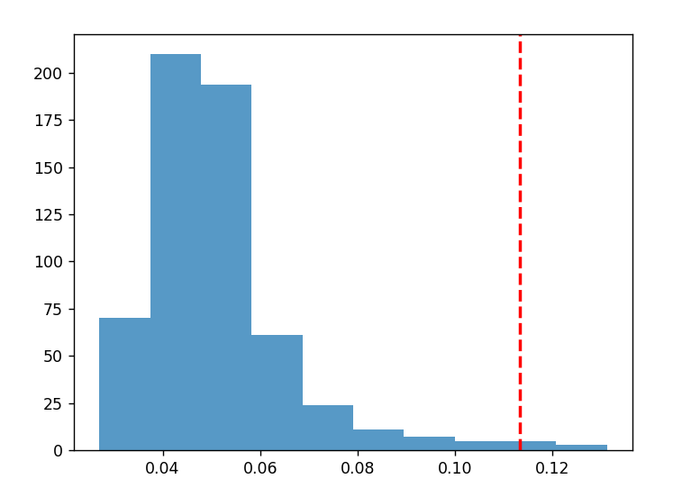
Failure Detection
1st Step: Application of Trained Neural Network to Healthy WTRs 1 and 2
Use of occurrence distribution – construction of histograms
99th Percentile
WTR 2 – Stage 3

Slide 15
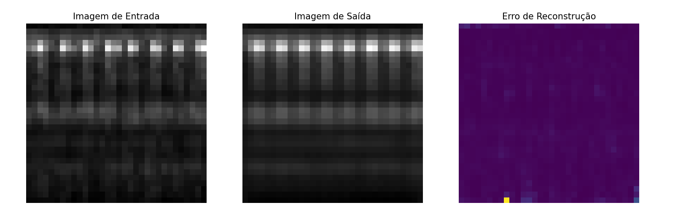
Failure Detection
1st Step: Application of Trained Neural Network to Healthy WTRs 1 and 2
WTR 2 – Stage 3

Slide 16
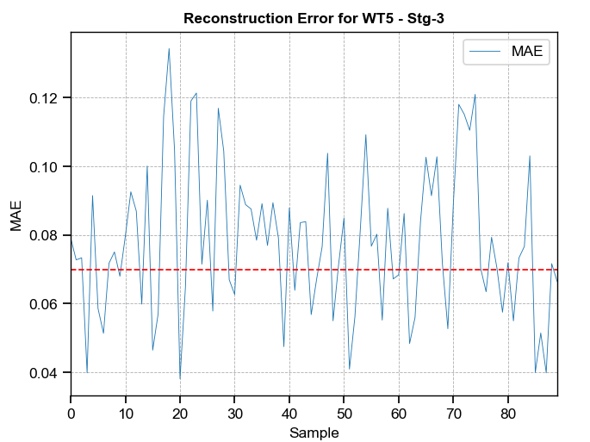
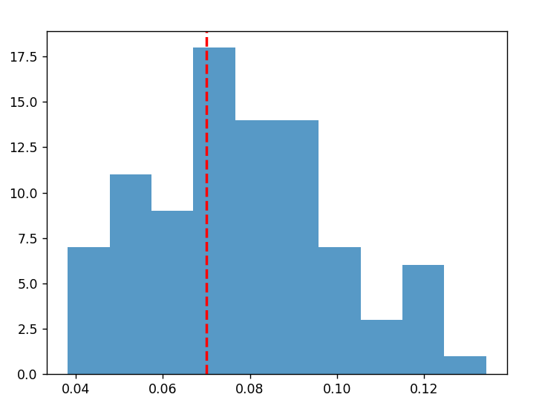
Failure Detection
2nd Step: Application of Trained Neural Network to Monitored WTs (WTR 1 – WT5)
Application of failure detection rule:
WT 5 – Anomalous Condition

Slide 17
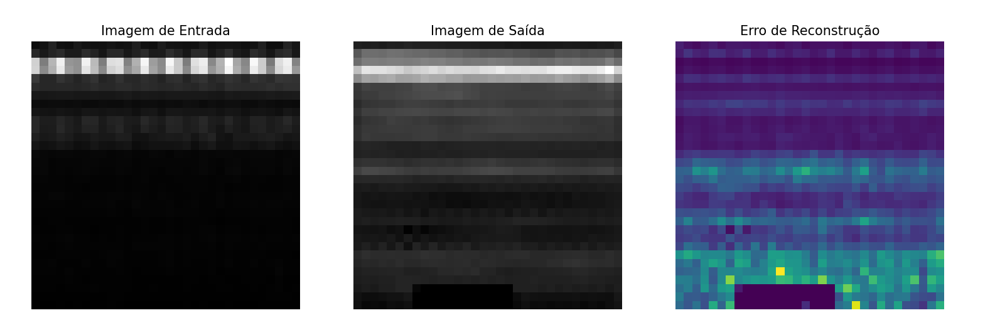
Failure Detection
2nd Step: Application of Trained Neural Network to Monitored WTs (WTR 1 – WT5)

Slide 18
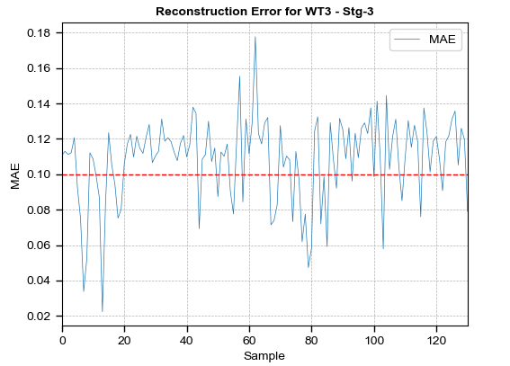
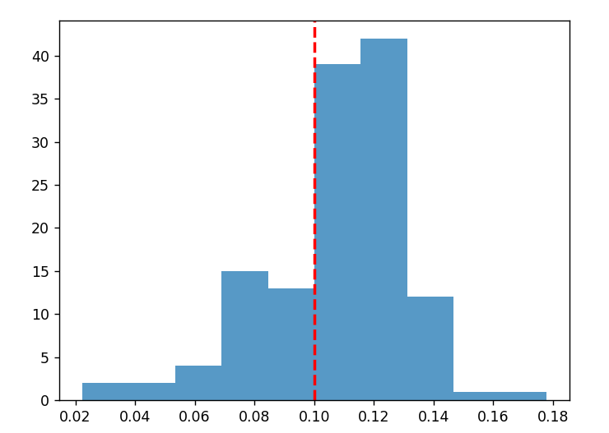
Failure Detection
2nd Step: Application of Trained Neural Network to Monitored WTs (WTR2 – WT3)
Application of failure detection rule:
WT 3 – Anomalous Condition

Slide 19
Failure Detection
Some advantages of the detection method:
WT5 has not shown CMS alert, even though borescope has demonstrated the failure
CNNs detected the failure in WT5, before traditional methods
WT3 in a more critical condition, with CMS alert, also detected by CNNs
Automatic detection
Degree of anomaly can be evaluated by the reconstruction error above defined threshold
Use of Physics-of-Failure approach for prognosis of RUL in WT3

Slide 20
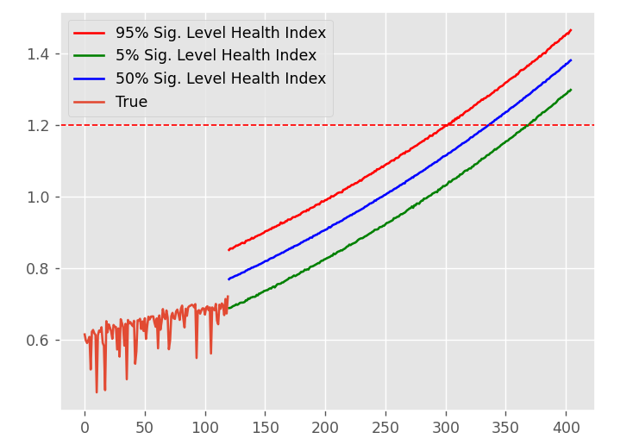
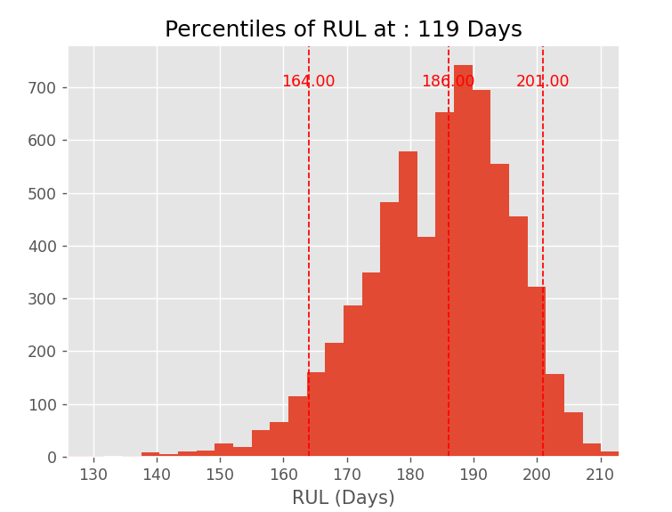
Failure Detection
Final Step: Use of PoF to run WT3 prognosis
WT 3 – Anomalous Condition. Estimation of RUL using Physics-of-Failure Methods

Slide 21
Conclusions
To summarize, our diagnosis solution for WT drivetrains gets CMS vibration data:
Process the time-series transforming for time-frequency information
Inputs to CNN-AE and allows run diagnosis
  Independent from the specific failure mode or frequency tracking
  Independent from frequency separation, analyzing all the spectrum
  Provides failure diagnosis in advance of traditional methods
Enables degree of anomaly estimation and prognosis solution
Predictive Maintenance
Future works: classification of failure modes and degree of anomaly

Slide 22


Project Team
Evoluce Tecnologia
Eduardo Menezes*
Hallason Matias
*eduardo.menezes@evolucetecnologia.com.br
eduardo.novaesmenezes@ufpe.br
AES Brasil
Priscilla Ghisi
Marlos Diógenes
Maurício Nunes
Thiago Costa
This study was developed based on project PD-0064-1076/2024 from the Research, Development, and Innovation Program of ANEEL

